Slide 1
NTM: ABRASIVE WATER JET MACHINING
Dr. G. Takyi

Slide 2
INSTRUCTIONAL OBJECTIVE
Identify the characteristics of conventional machining
Identify the characteristics of non conventional machining
Differentiate between conventional and non traditional machining
Classify different non traditional machining process
Identify the need for non traditional machining processes
Describe the basic mechanism of material removal in AJM
Identify major components of AJM equipment

Slide 3
INSTRUCTIONAL OBJECTIVE
State the working principle of AJM equipment
Draw schematically the AJM equipment
Identify the machining characteristics of AJM
Analyse the effect of process parameters on MRR
Draw variation in MRR with different process parameters
Develop mathematical model relating MRR with AJM parameters
List three applications and limitations of AJM

Slide 4
MANUFACTURING – Classifications
Primary Manufacturing
To impact basic shape and size
Liquid stage forming processes-casting
Solid stage forming processes
All metal working processes- forging, rolling, extrusion, etc.
Power stage forming processes- power metallurgy
Secondary Manufacturing
To impart final shape and size with tight control on dimension and shape
Mostly material removal processes

Slide 5
CONVENTIONAL MACHINING PROCESSES (milling, turning, broaching etc.)
Material removal due to application of cutting forces
Energy domain- mechanical
Macroscopic chip
Chip formation due to shear deformation
Cutting tool is harder

Slide 6
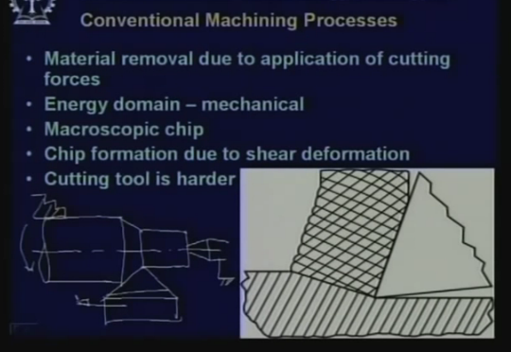
5 Characteristics of conventional machining, job giving rotation, tool giving feed

Slide 7
Characteristics of NON- TRADITIONAL MACHINING PROCESSES
Material removal – chip formation or even no chip formation
AJM- microscopic size
ECM- electrochemical dissolution at atomic level
Physical tool- may be absent
LBM, machining is carried out by laser beam
WJM, machining is done by a high pressure water jet
EDM, a physical tool is very much required
ECM, similarly requires a tool
-

Slide 8
NON- TRADITIONAL MACHINING PROCESSES
Tool need not be harder than the work piece
- EDM, copper is used as the tool material to machine hardened steels
Energy domain- not necessarily mechanical
- different energy domains for machining
- USM,AJM,WJM mechanical energy
- EDM, electro-thermal energy

Slide 9
CLASSIFICATION OF NTM PROCESSES
Mechanical Processes
Abrasive Jet Machining (AJM)
Ultrasonic Machining (USM)
Water Jet Machining (WJM)
Abrasive Water Jet Machining (AWJM)
Electrochemical Processes
Electrochemical Machining (ECM)
Electro Chemical Grinding (ECG)
Electro Jet Drilling (EJD)

Slide 10
Electro-thermal
EDM
EBM
LJM

Slide 11
WHY THE NEED FOR NTM PROCESSES
Exotic Materials: innovative design and requirement, tighter tolerances and micromachining, economy
Intricate shaped blind hole- e.g. square hole of 15mm x 15mm with a depth of 30mm
Difficult to machine material- e.g same example as above in inconel, Ti-alloys or carbons
Low Stress Grinding- Electrochemical Grinding is preferred as compared to conventional grinding
Deep hole with small hole diameter- e.g. Φ 1.5 mm hole with Vd=20
Machining of composites

Slide 12
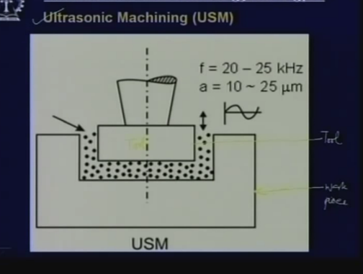

Slide 13
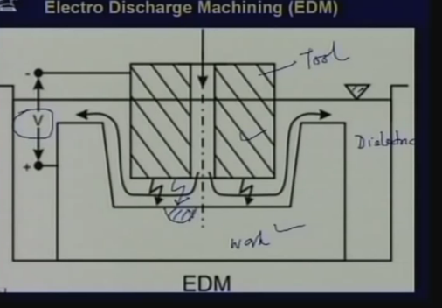

Slide 14
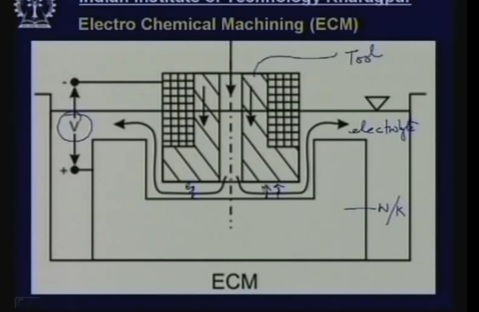

Slide 15
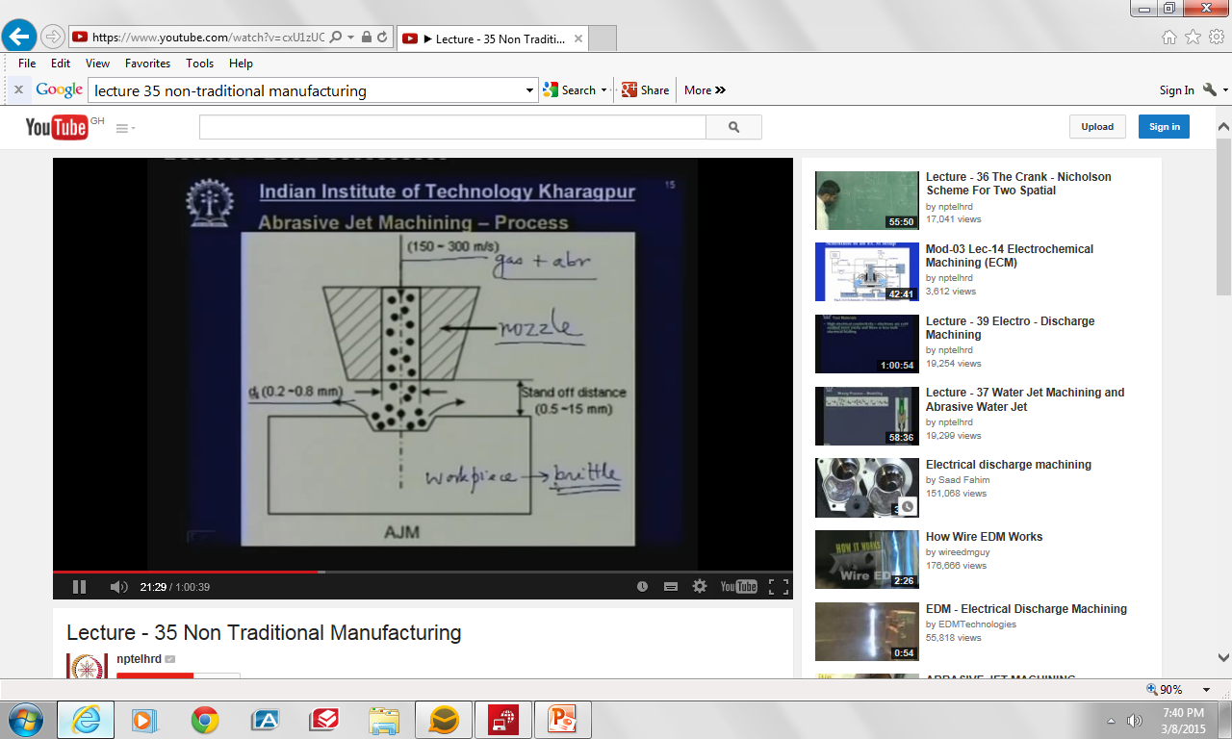

Slide 16


Slide 17
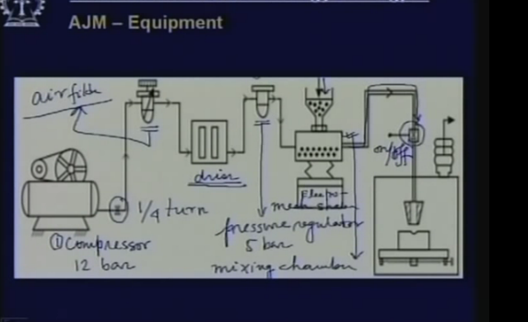

Slide 18
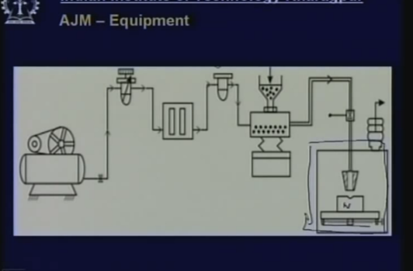

Slide 19
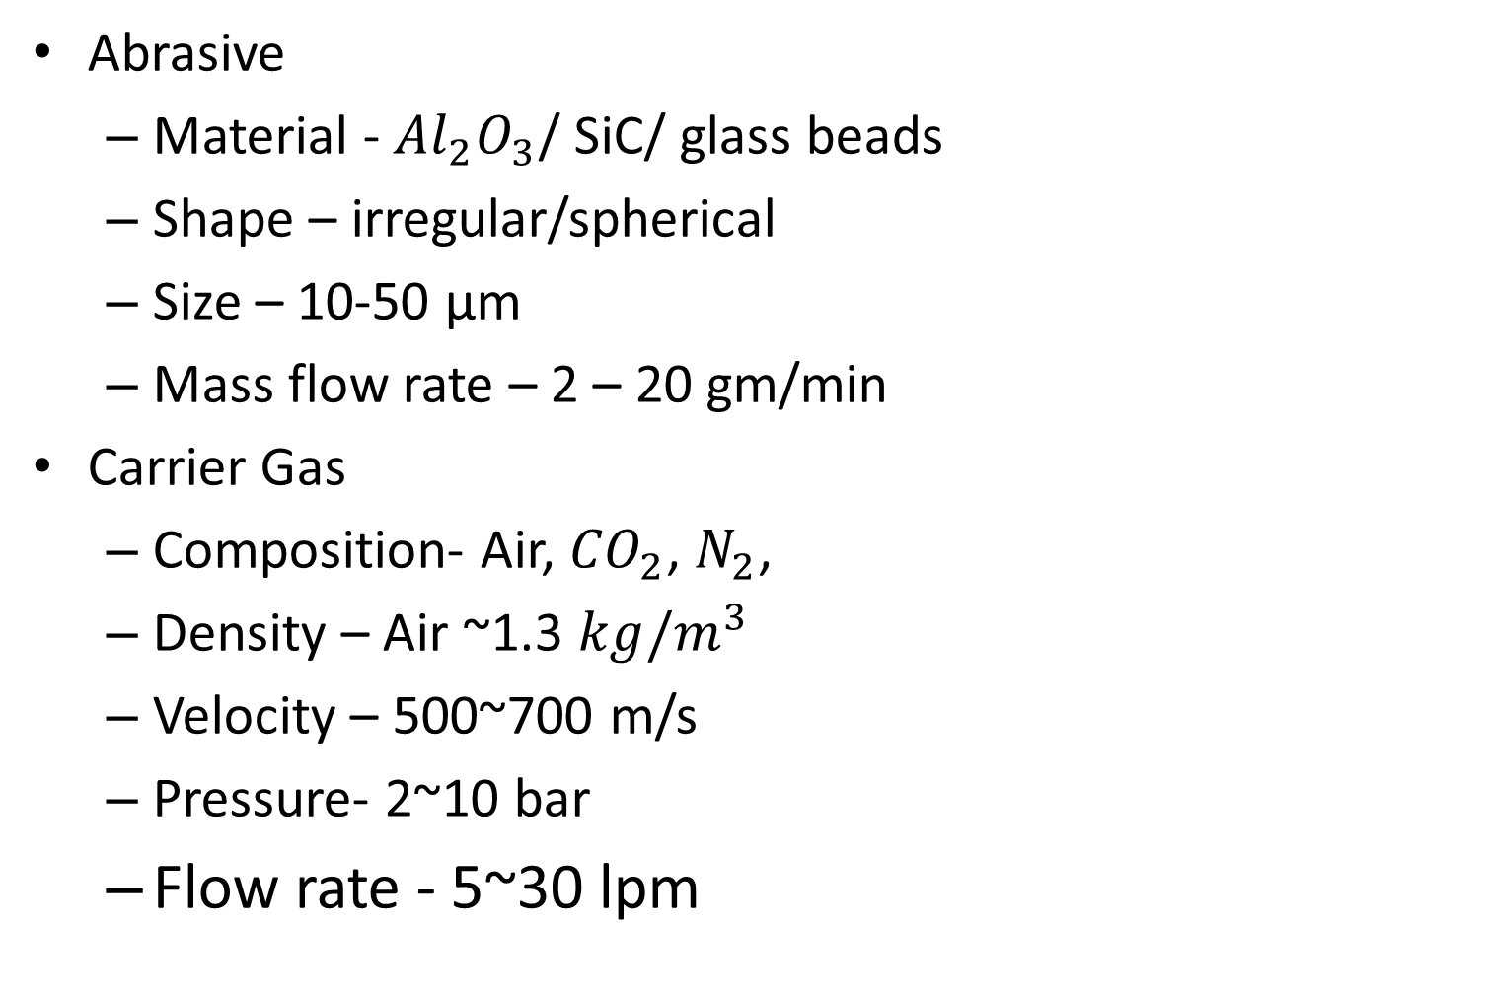
PROCESS VARIABLES
Abrasive
Material - ${Al}_{2}O_{3}$/ SiC/ glass beads
Shape – irregular/spherical
Size – 10-50 µm
Mass flow rate – 2 – 20 gm/min
Carrier Gas
Composition- Air, ${CO}_{2}$, $N_{2}$,
Density – Air ~1.3 ${kg/m}^{3}$
Velocity – 500~700 m/s
Pressure- 2~10 bar
Flow rate - 5~30 lpm

Slide 20
PROCESS VARIABLES
Abrasive Jet
Velocity - 100 – 300m/s
Burning ratio – mass flow ratio of abrasive to gas
Stand-off distance – 0.5 ~ 5 mm
Impingement Angle - 60° ~ 90°
Nozzle
Material- WC/ Sapphire
Diameter – (internal) 0.2~ 0.8 mm
Life - 10 ~ 300 hours

Slide 21
MODELING OF MATERIAL REMOVAL IN AJM
Brittle materials are considered to fall due to brittle fracture
The fracture volume is considered to be hemispherical with diameter equal to chordal length of the indentation
The ductile material, removal volume is assumed to be equal to the indentation volume due to particulate impact
The kinetic energy of the abrasives are fully utilized in removing material
Abrasives are spherical in shape and rigid
The particles are characterized by the mean grit diameter

Slide 22
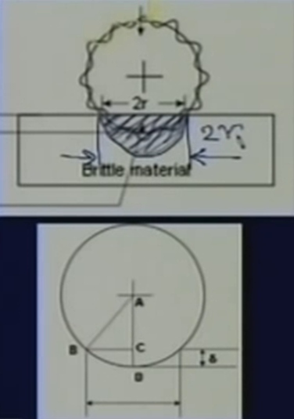
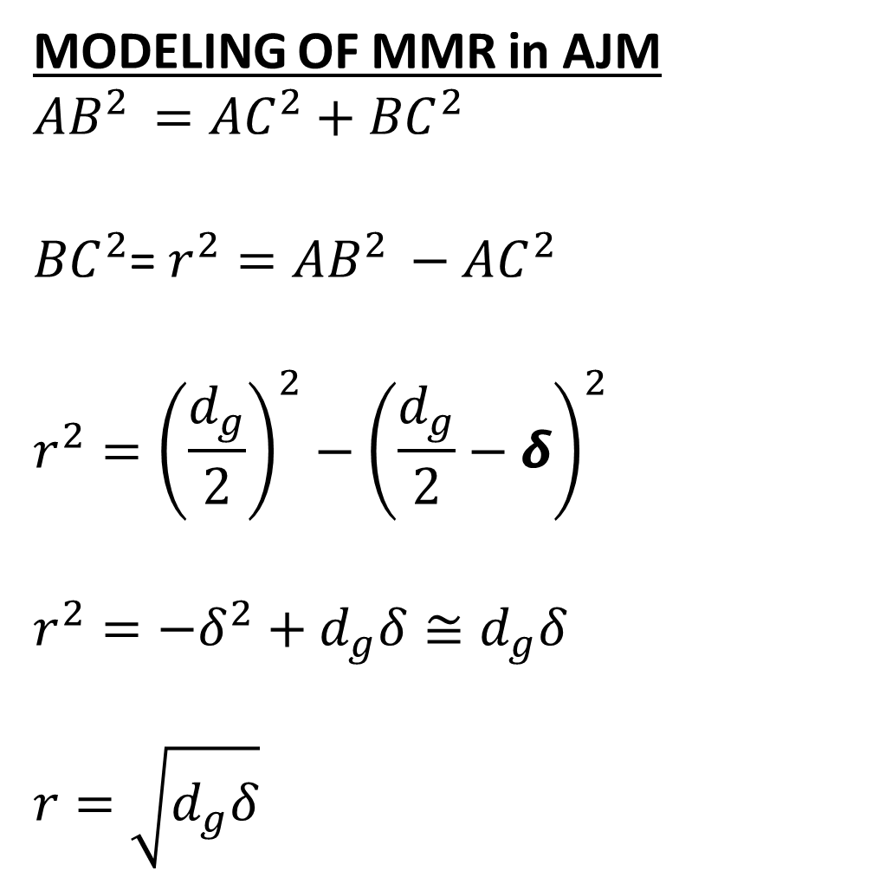
Single impact material removal
MODELING OF MMR in AJM
$${AB}^{2 }={AC}^{2}+{BC}^{2}$$
${BC}^{2}$= $r^{2}={AB}^{2 }−{AC}^{2}$
$$r^{2}={\left(\frac{d_{g}}{2}\right)}^{2}−{\left(\frac{d_{g}}{2}−δ\right)}^{2}$$
$$r^{2}=−δ^{2}+d_{g}δ≅d_{g}δ$$
$$r=\sqrt{d_{g}δ}$$

Slide 23
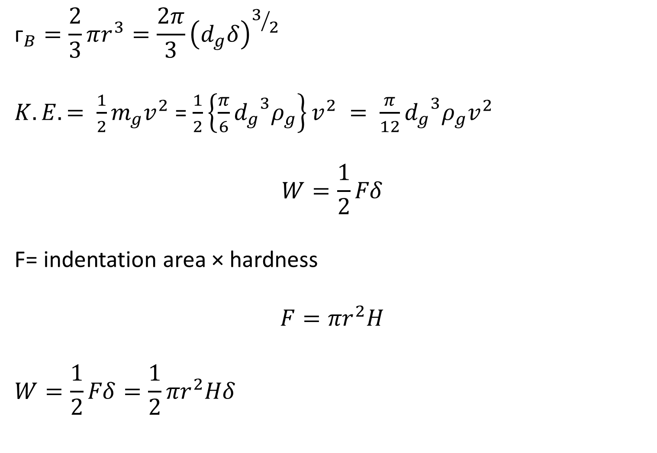
MODELING OF MMR IN AJM
$${\text{ᴦ}}_{B}=\frac{2}{3}πr^{3}=\frac{2π}{3}{\left(d_{g}δ\right)}^{3/2}$$
$K.E. = \frac{1}{2}m_{g}v^{2}$ = $\frac{1}{2}\left\{\frac{π}{6}{d_{g}}^{3}ρ_{g}\right\}v^{2} = \frac{π}{12}{d_{g}}^{3}ρ_{g}v^{2}$
$$W=\frac{1}{2}Fδ$$
F= indentation area × hardness
$$F={πr}^{2}H$$
$$W=\frac{1}{2}Fδ=\frac{1}{2}{πr}^{2}Hδ$$

Slide 24
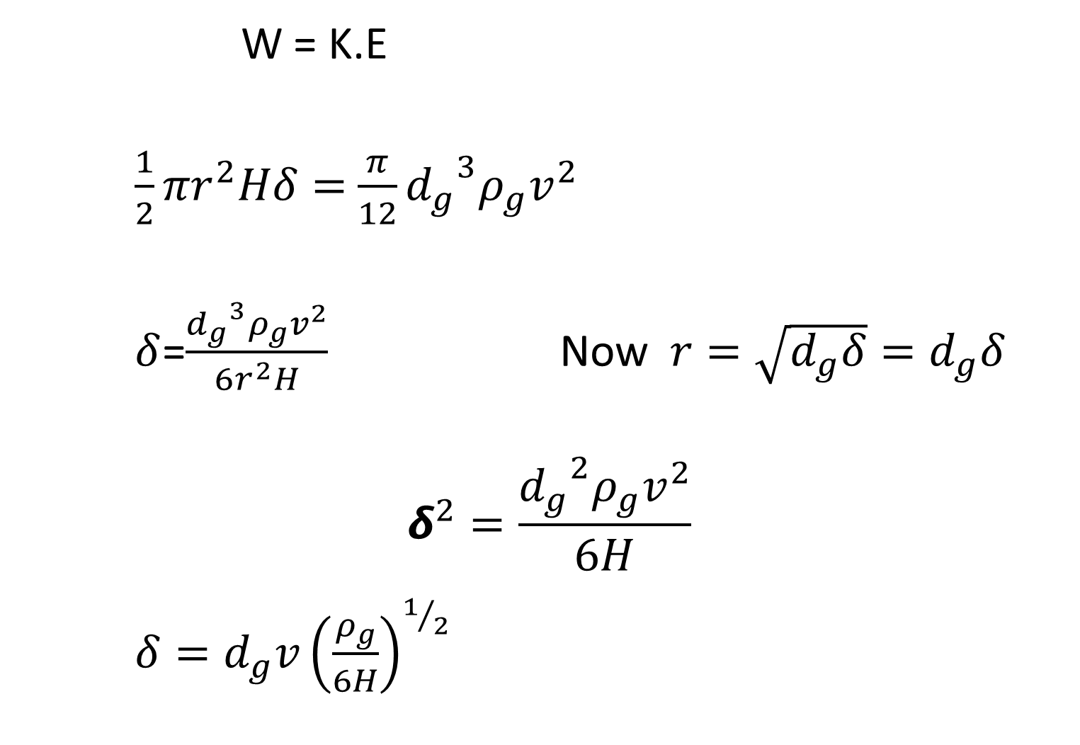
MODELING OF MMR in AJM
W = K.E
$$\frac{1}{2}{πr}^{2}Hδ=\frac{π}{12}{d_{g}}^{3}ρ_{g}v^{2}$$
$δ$=$\frac{{d_{g}}^{3}ρ_{g}v^{2}}{6r^{2}H}$ Now $r=\sqrt{d_{g}δ}=d_{g}δ$
$$δ^{2}=\frac{{d_{g}}^{2}ρ_{g}v^{2}}{6H}$$
$$δ=d_{g}v{\left(\frac{ρ_{g}}{6H}\right)}^{1/2}$$

Slide 25
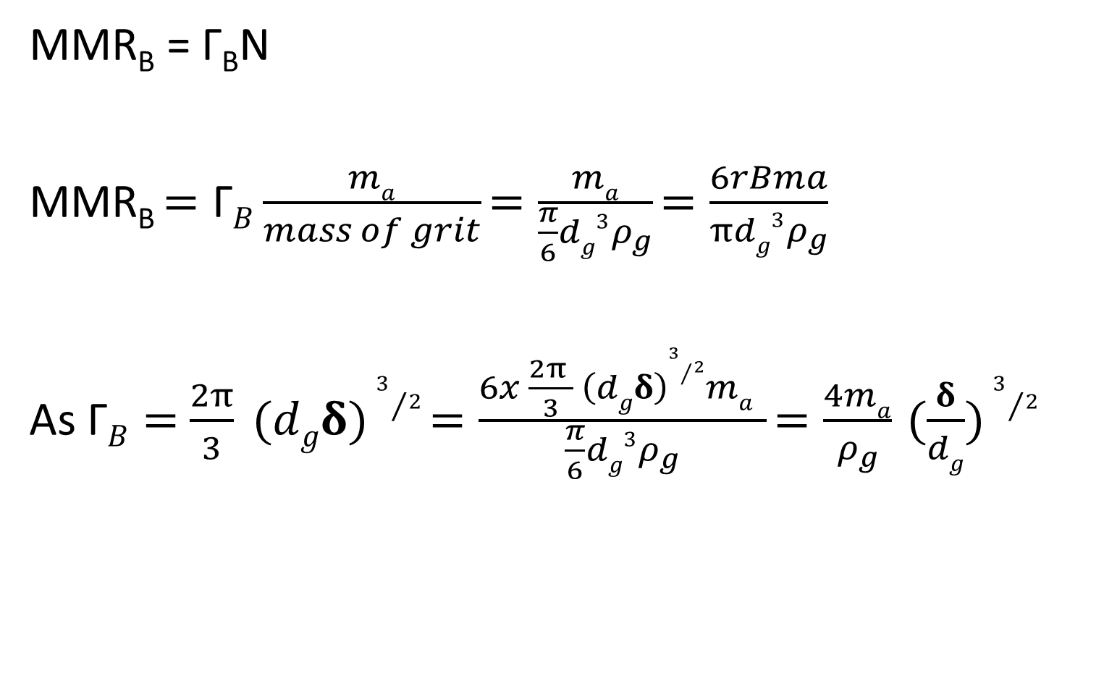
MATERIAL REMOVAL RATE
MMR_{B} = Γ_{B}N
MMR_{B} $=\text{Γ}B\frac{ma}{mass of grit}$ $=\frac{ma}{\frac{π}{6}dg3ρ_{g}}$ $=\frac{6rBma}{πdg3ρ_{g}}$
As $\text{Γ}B=$ $\frac{2π}{3} (dgδ)3/2$ $=\frac{6x \frac{2π }{3} \left(dgδ\right)3/2ma }{\frac{π}{6}dg3ρ_{g}}$ $=\frac{4ma}{ρ_{g}}$ $(\frac{δ}{dg})$ $3/2$

Slide 26
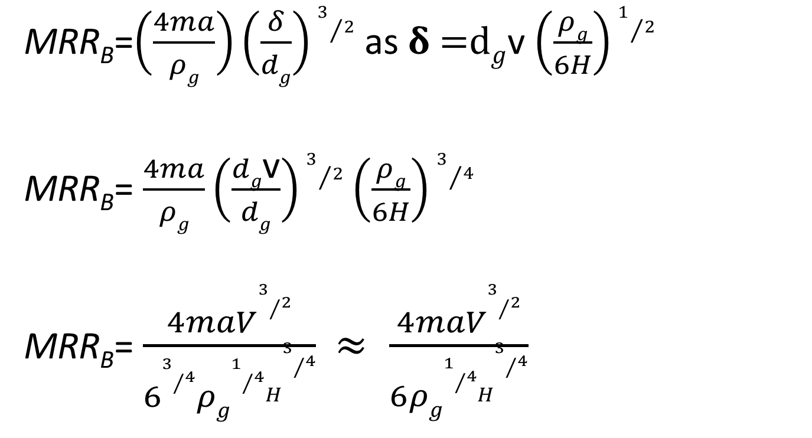
Volume of material removed in a single impact
MRR_{B}=$\left(\frac{4ma}{ρg}\right)\left(\frac{δ}{dg}\right)3/2$ as 𝛅 =d$g$v $\left(\frac{ρg}{6H}\right)1/2$
MRR_{B}= $\frac{4ma}{ρg}\left(\frac{dg\text{v}}{dg}\right)3/2$ $\left(\frac{ρg}{6H}\right)3/4$
MRR_{B}= $\frac{4maV3/2}{\begin{aligned} \\ 63/4ρg1/4\end{aligned}H3/4} ≈ \frac{4maV3/2}{\begin{aligned} \\ 6ρg1/4\end{aligned}H3/4}$

Slide 27
MMR = Amount of material removed in a single impact x number of impacts.
Number of impacts is mass flow rate of abrasives divided by the mass of a single grit

Slide 28
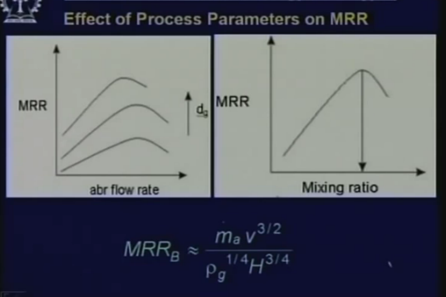

Slide 29
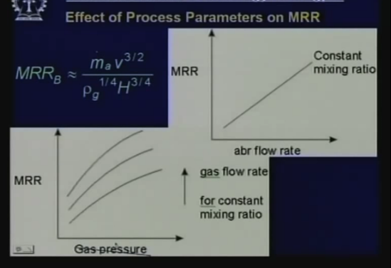

Slide 30
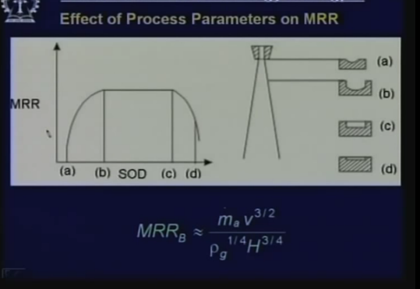

Slide 31
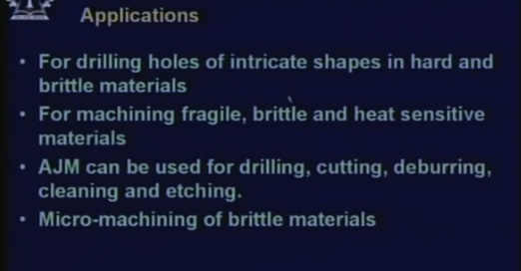

Slide 32
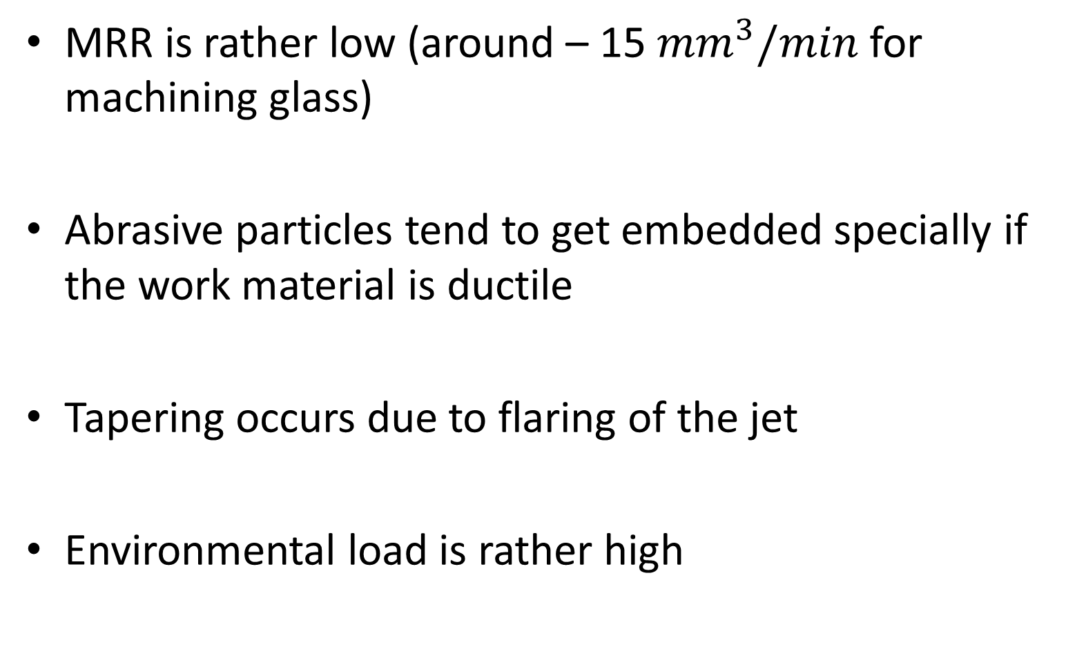
LIMITATIONS
MRR is rather low (around – 15 ${mm}^{3}/min$ for machining glass)
Abrasive particles tend to get embedded specially if the work material is ductile
Tapering occurs due to flaring of the jet
Environmental load is rather high

Slide 33
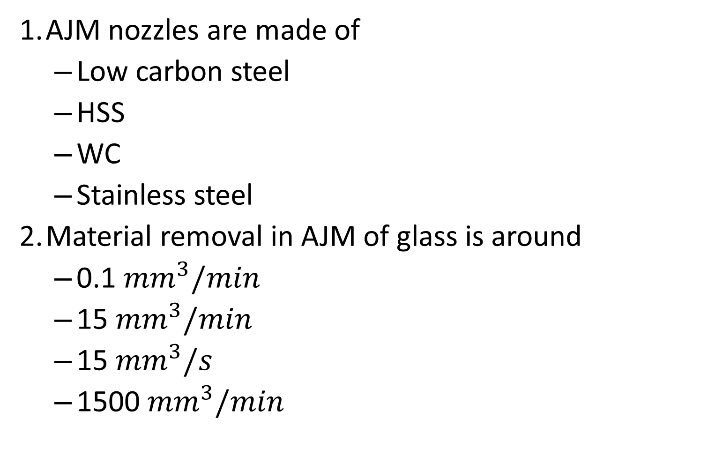
QUIZ
AJM nozzles are made of
Low carbon steel
HSS
WC
Stainless steel
Material removal in AJM of glass is around
0.1 ${mm}^{3}/min$
15 ${mm}^{3}/min$
15 ${mm}^{3}/s$
1500 ${mm}^{3}/min$

Slide 34
QUIZ
3. Material removal takes place in AJM due to
Electrochemical action
Mechanical impact
Fatigue failure of the material
Sparking on impact
4. As the stand off distance increases beyond 5 mm, the depth of penetration in AJM
Increases
Decreases
Does not change
Initially increases and then remains steadily

Slide 35
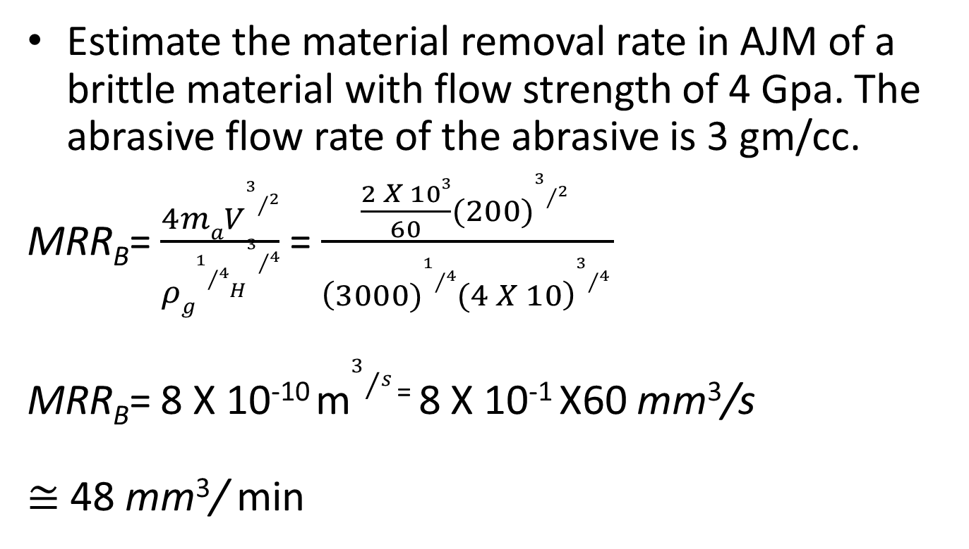
Solved problem - 1
Estimate the material removal rate in AJM of a brittle material with flow strength of 4 Gpa. The abrasive flow rate of the abrasive is 3 gm/cc.
MRR_{B}= $\frac{4maV3/2}{\begin{aligned} \\ ρg1/4\end{aligned}H3/4}$ = $\frac{\frac{2 X 103}{60}(200)3/2 }{\begin{aligned}\begin{aligned} \\ \left(3000)1/4(4 X 10\right)3/4\end{aligned}\end{aligned} }$
MRR_{B}= 8 X 10⁻¹⁰ m$3/{s }$⁼ 8 X 10⁻¹ X60 mm³/s
$≅$ 48 mm³/ min

Slide 36
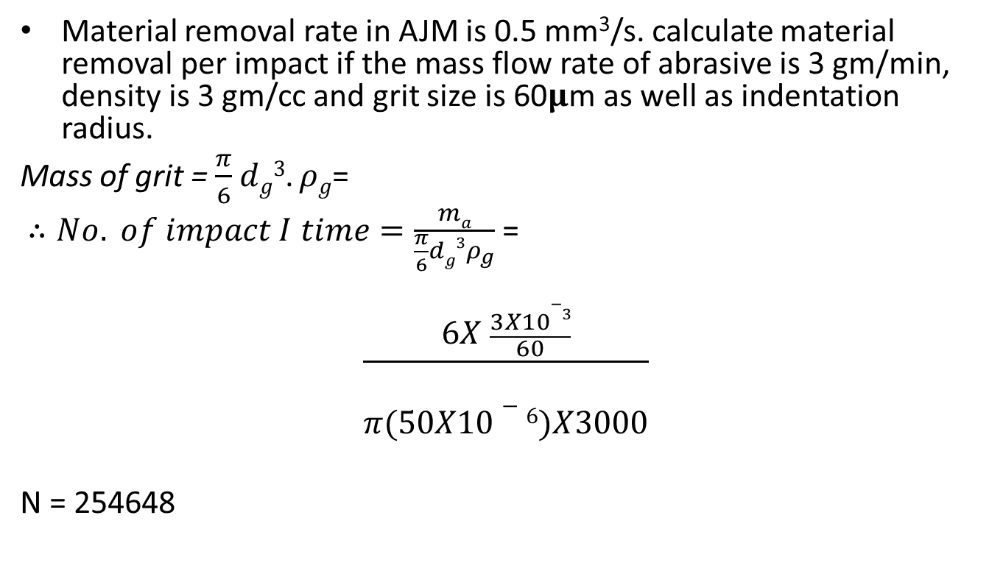
Solved problem - 2
Material removal rate in AJM is 0.5 mm³/s. calculate material removal per impact if the mass flow rate of abrasive is 3 gm/min, density is 3 gm/cc and grit size is 60𝛍m as well as indentation radius.
Mass of grit = $\frac{π}{6}$ $dg3$. $ρg$=
$∴No. of impact I time=\frac{ma}{\frac{π}{6}dg3ρ_{g}}$ =
$$\frac{6X \frac{3X10−3}{60}}{\begin{aligned} \\ π(50X10−6)X3000\end{aligned}}$$
N = 254648

Slide 37
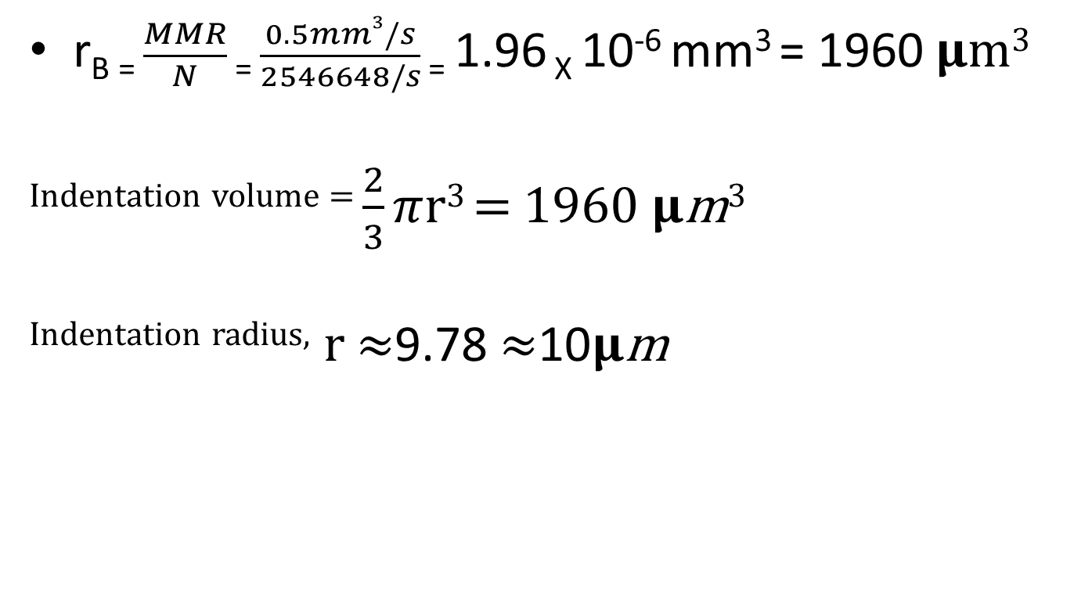
Solved problem – cont.
r_{B =} $\frac{MMR}{N}$ ₌ $\frac{0.5mm3/s}{2546648/s}$ ₌ 1.96 _{X} 10⁻⁶ mm³ = 1960 𝛍m³
^{Indentation volume =} $\frac{2}{3}$ $π$r³ = 1960 𝛍m³
^{Indentation radius,} r $≈$9.78 $≈$10𝛍m

